Slide 1
Implementing VPN Solutions with FortiGate – Network Segmentation (VLANs)
Presented by:
Kholoud Elsokkary

Slide 2
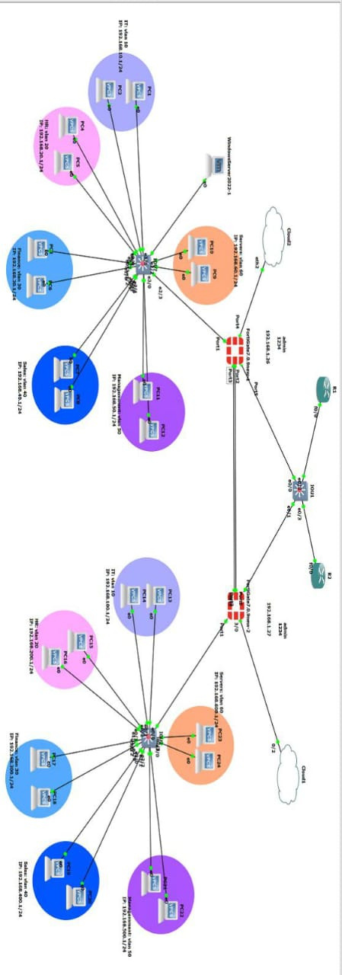
PROJECT OVERVIEW
“Our project focuses on designing and implementing secure VPN solutions using FortiGate firewalls. Over four weeks, we worked on SSL VPN, IPsec VPN tunnels, and finally optimized the traffic using Fortinet SD-WAN.
Before building any VPN solution, the network must be well-structured, segmented, and ready for routing. My part of the project was to prepare this internal network, create VLAN segmentation, configure Layer 2 switching, and ensure proper communication with the FortiGate firewall. This segmentation became the foundation that allowed us to apply firewall policies and build VPN connections in the next stages.”

Slide 3
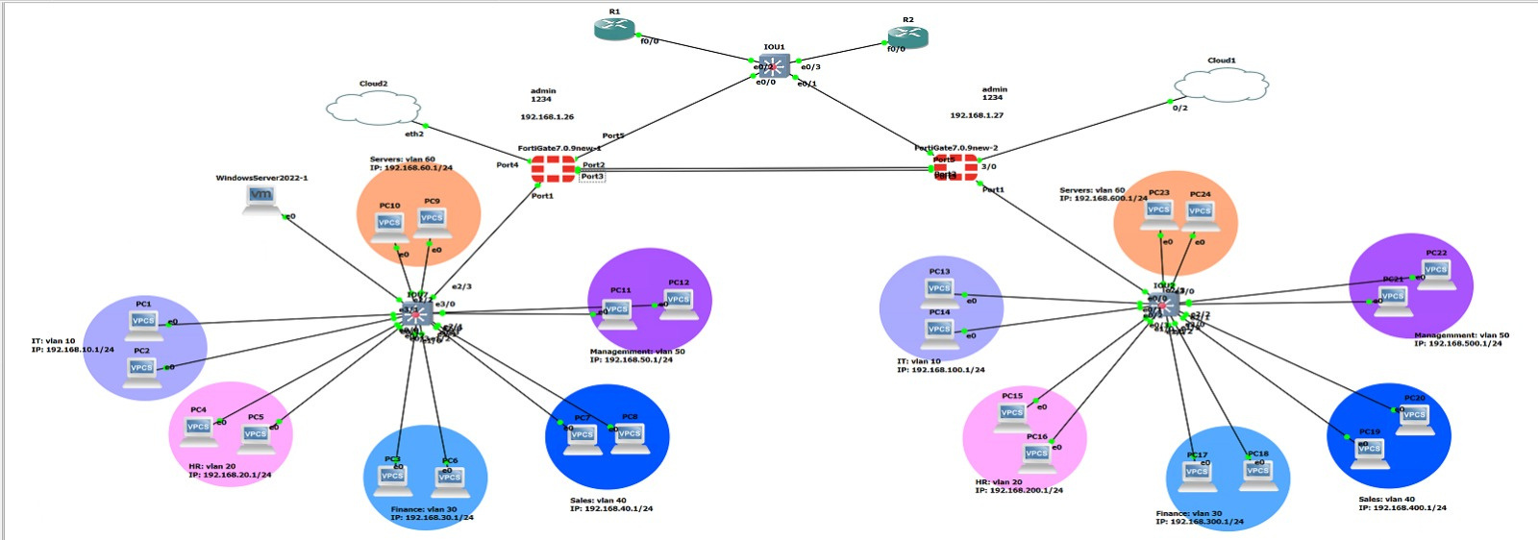
Network Segmentation and VLAN Setup
MY TASK IN THE PROJECT
Designed full VLAN segmentation for all departments
Configured Access Ports & Trunk link
Built SVI interfaces for inter-VLAN routing through FortiGate
Enabled DHCP relay for centralized IP distribution
Verified connectivity to prepare the environment for VPN setup

Slide 4
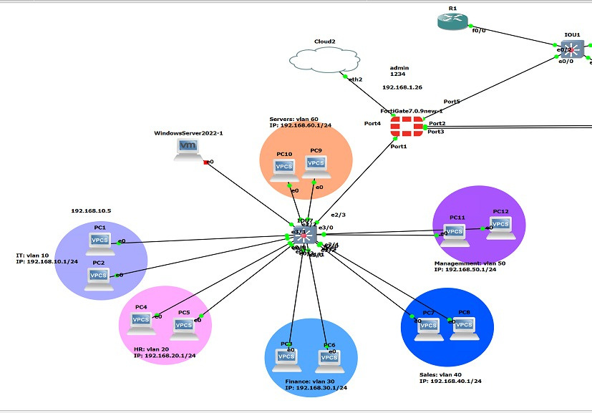
WHY VLAN SEGMENTATION?
Purpose of Creating VLANs
Improve network security
Limit broadcast domains and reduce congestion
Separate departments for better access control
Prepare clear subnets for VPN policies
Enable centralized DHCP and easier troubleshooting

Slide 5
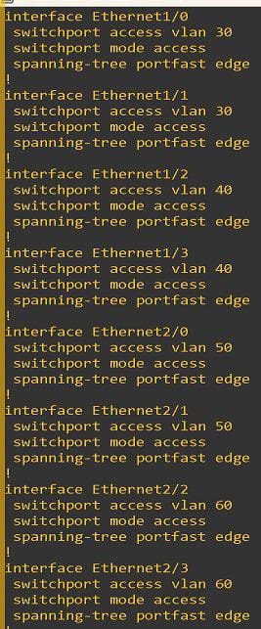
VLANS I CREATED
Defined VLANs and Departments
VLAN Name Purpose
10 IT Technical staff devices
20 HR HR users and systems
30 Finance Financial department
40 Sales Sales team
50 Management Management devices
80 Servers Internal servers network
“These VLANs form the core segmentation that the VPN will later control using policies.”

Slide 6
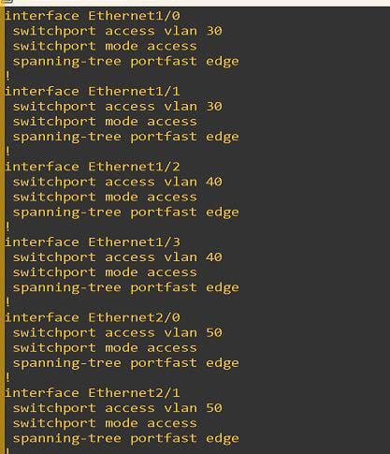
ACCESS PORT CONFIGURATION
Configuring Access Ports
“I configured Access ports for each department. Each port is assigned to one VLAN only, and PortFast was enabled to speed up device connectivity.”
interface Ethernet0/0
switchport mode access
switchport access vlan 10
spanning-tree portfast

Slide 7
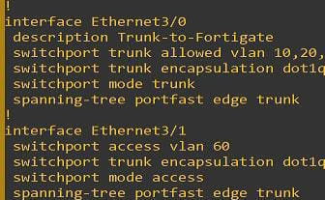
TRUNK LINK TO THE FORTIGATE
Trunk Configuration (Switch ↔ FortiGate)
“This trunk allows all VLAN traffic to pass to the FortiGate using 802.1Q encapsulation. The firewall performs inter-VLAN routing and applies VPN/security policies.”
interface Ethernet3/0
description TRUNK-to-FortiGate
switchport trunk encapsulation dot1q
switchport mode trunk
switchport trunk allowed vlan 10,20,30,40,50

Slide 8
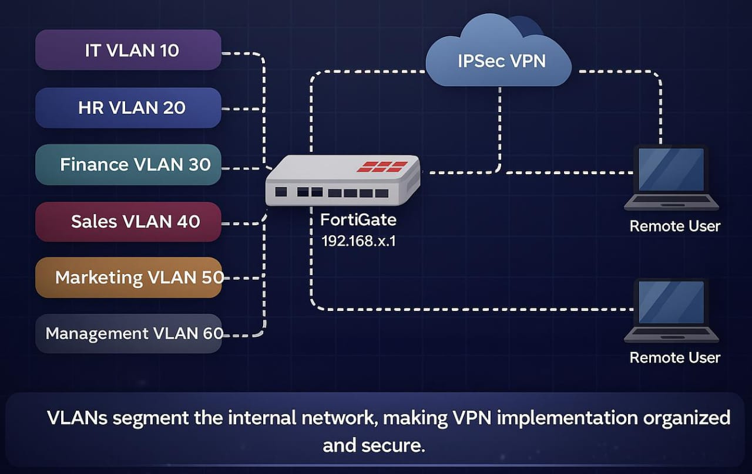
Preparing the Network for VPN Implementation
How My Work Supports the VPN
“Although I didn’t configure the VPN myself, my work on VLANs and network setup created the foundation for it. By organizing the network, setting up subnets, gateways, and DHCP, I made it easier for the team to implement VPNs, apply firewall policies, and ensure secure connectivity. Essentially, I prepared the internal network environment so the VPN could function correctly.”

Slide 9
SUMMARY OF MY PART
In summary, this project gave me the chance to apply the skills I learned in a real practical scenario.
I was able to build the network step-by-step, document the process clearly, and troubleshoot issues professionally.
Overall, it helped me improve my technical skills and understand how networks work in real environments.

Slide 10
“THANKS FOR LISTENING AND YOUR ATTENTION!”

